Slide 1
Computer Vision fundamentals

Slide 2
Contents
Computer Vision Introduction: Color theory
Image Formats
Computer Vision Metrics

Slide 3
Computer Vision Introduction: Color theory

Slide 4
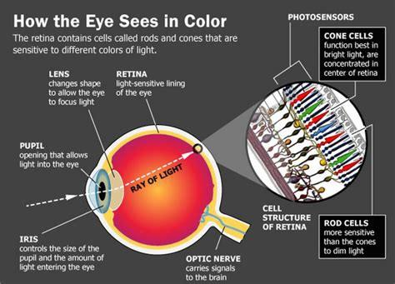
The human eye
Cones are a type of photoreceptor cell in the retina. They give us our color vision. Cones are concentrated in the center of our retina in an area called the macula and help us see fine details
Rods are a type of photoreceptor cell in the retina. They are sensitive to light levels and help give us good vision in low light. They are concentrated in the outer areas of the retina and give us peripheral vision. Rods are 500 to 1,000 times more sensitive to light than cones.
https://www.aao.org/eye-health/anatomy/rods#:~:text=Rods%20are%20a%20type%20of,sensitive%20to%20light%20than%20cones.
Image Source: https://medium.com/a-history-of-color/how-the-eye-percieves-color-93a3f10e03d9

Slide 5
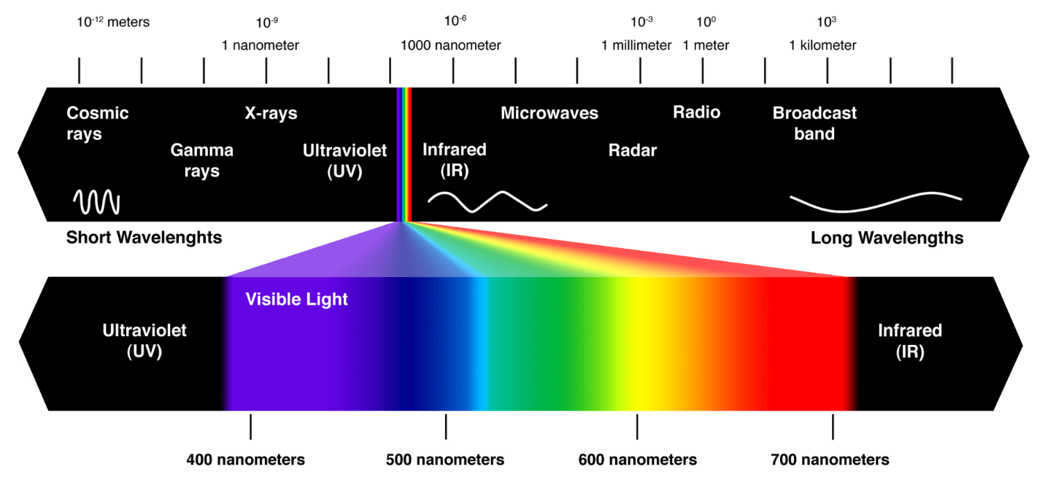
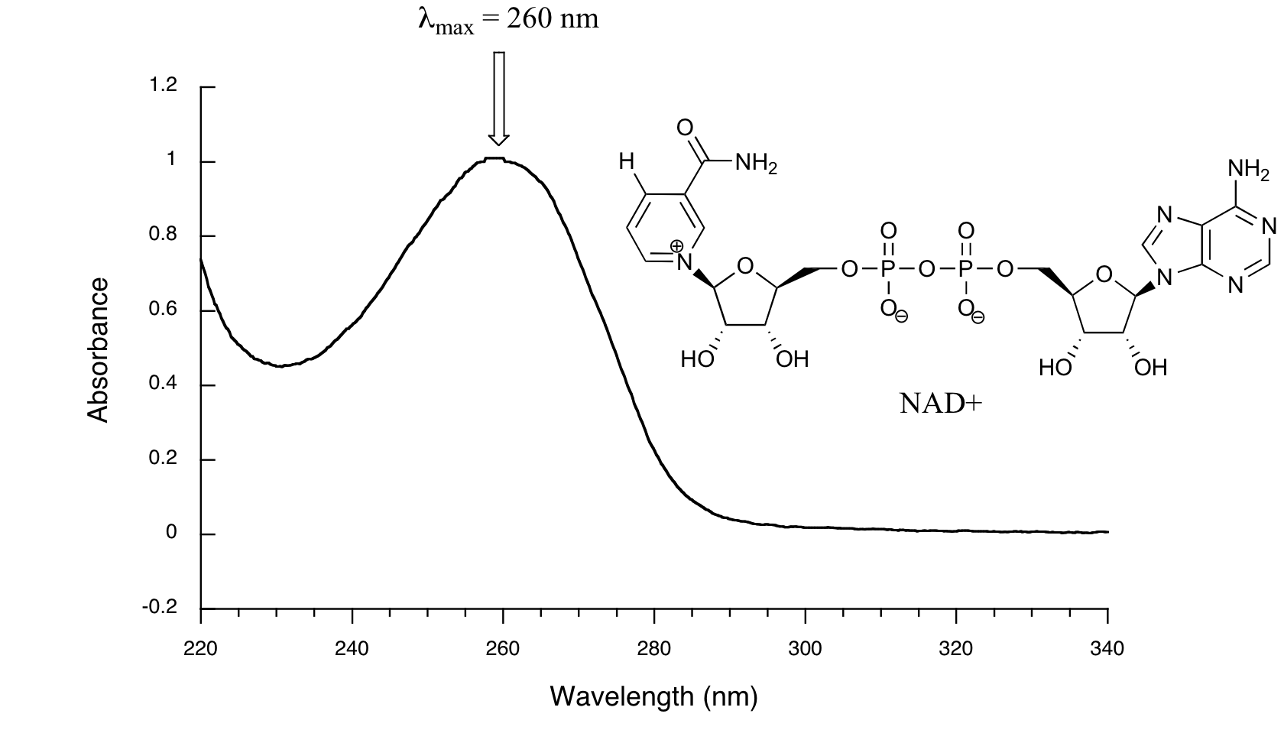
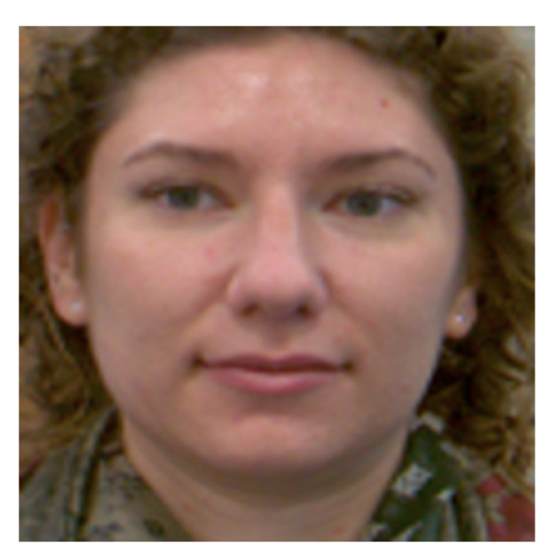
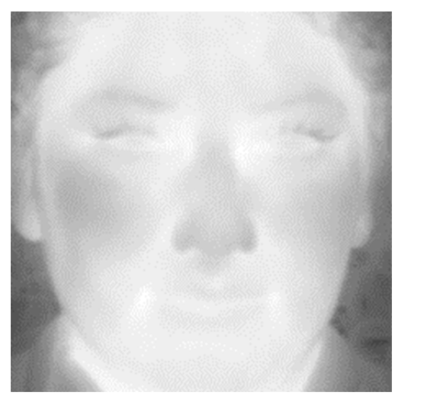
Light and colors
https://chem.libretexts.org/Bookshelves/Organic_Chemistry/Introduction_to_Organic_Spectroscopy/03%3A_Conjugated_Compounds_and_Ultraviolet_Spectroscopy/3.06%3A_Interpreting_Ultraviolet_Spectra
Image source: Kowalski, M.; Grudzień, A.; Mierzejewski, K. Thermal–Visible Face Recognition Based on CNN Features and Triple Triplet Configuration for On-the-Move Identity Verification. Sensors 2022, 22, 5012. https://doi.org/10.3390/s22135012
https://www.oncelighting.eu/visible-light-spectrum/

Slide 6
Color Space and color model
A color space is a specific organization of colors.
A color space may be arbitrary, i.e. with physically realized colors assigned to a set of physical color swatches with corresponding assigned color names (including discrete numbers in – for example – the Pantone collection), or structured with mathematical rigor (as with the NCS System, Adobe RGB and sRGB)
A "color model" is an abstract mathematical model describing the way colors can be represented as tuples of numbers (e.g. triples in RGB or quadruples in CMYK)

Slide 7
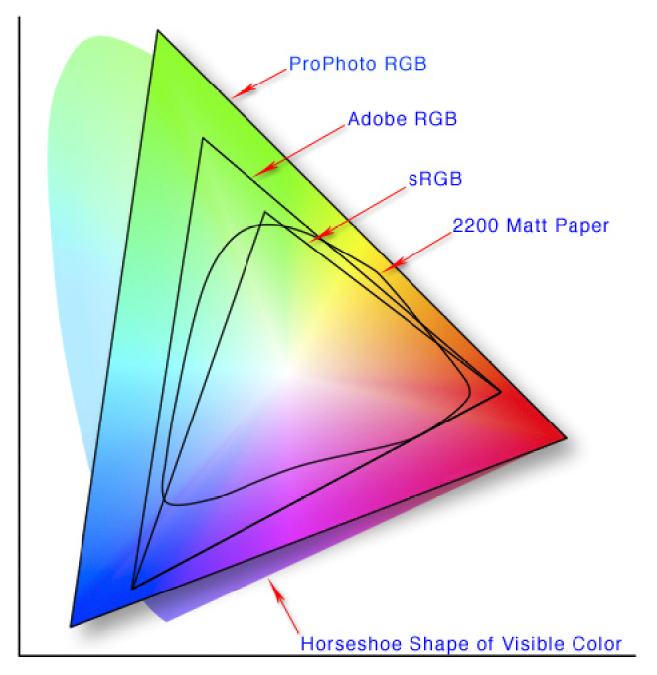
Different color spaces
https://en.wikipedia.org/wiki/Color_space

Slide 8
Color Depth
Color depth also known as bit depth, is either the number of bits used to indicate the color of a single pixel
When referring to a pixel, the concept can be defined as bits per pixel (bpp)
When referring to a color component, the concept can be defined as bits per component, bits per channel, bits per color (all three abbreviated bpc)

Slide 9
Color Gamut
In color reproduction, including computer graphics and photography, the gamut, or color gamut, is a certain complete subset of colors.
The most common usage refers to the subset of colors which can be accurately represented in a given circumstance, such as within a given color space or by a certain output device.

Slide 10
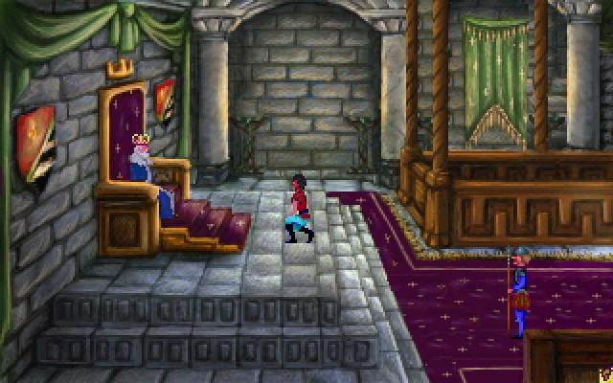
VGA – Video Graphics Array
Standard graphics modes
640×480 in 16 colors or monochrome
640×350 or 640×200 in 16 colors or monochrome (EGA compatibility)
320×200 in 256 colors (Mode 13h)
320×200 in 4 or 16 colors (CGA compatibility)

Slide 11
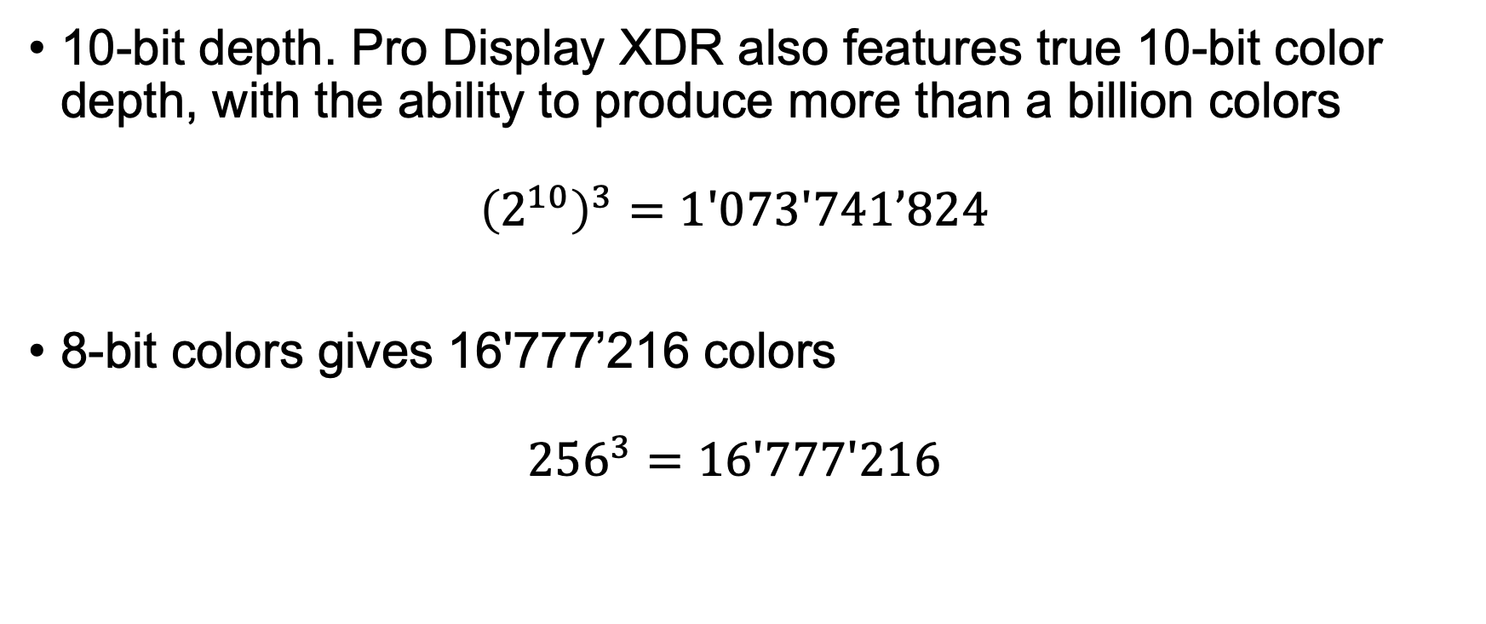
Modern Monitors color depth

Slide 12
Image Formats

Slide 13
Raster and Vector images
Raster Images
  Image made of pixels
  Resolution dependent (cannot be scaled up or down without loss of quality)
  Raster Formats: jpeg, jpg, pgf, png,, raw, rgba, tif, tiff
Vector Images
  Made of lines and curves drawn with mathematical equations (Bezier curves for example, see https://pomax.github.io/bezierinfo/)
  Not resolution related
  Can be resized without loss of quality
  Vector Formats: svg, svgz, eps, pdf, ps
In Deep Learning we work with Raster images only.

Slide 14
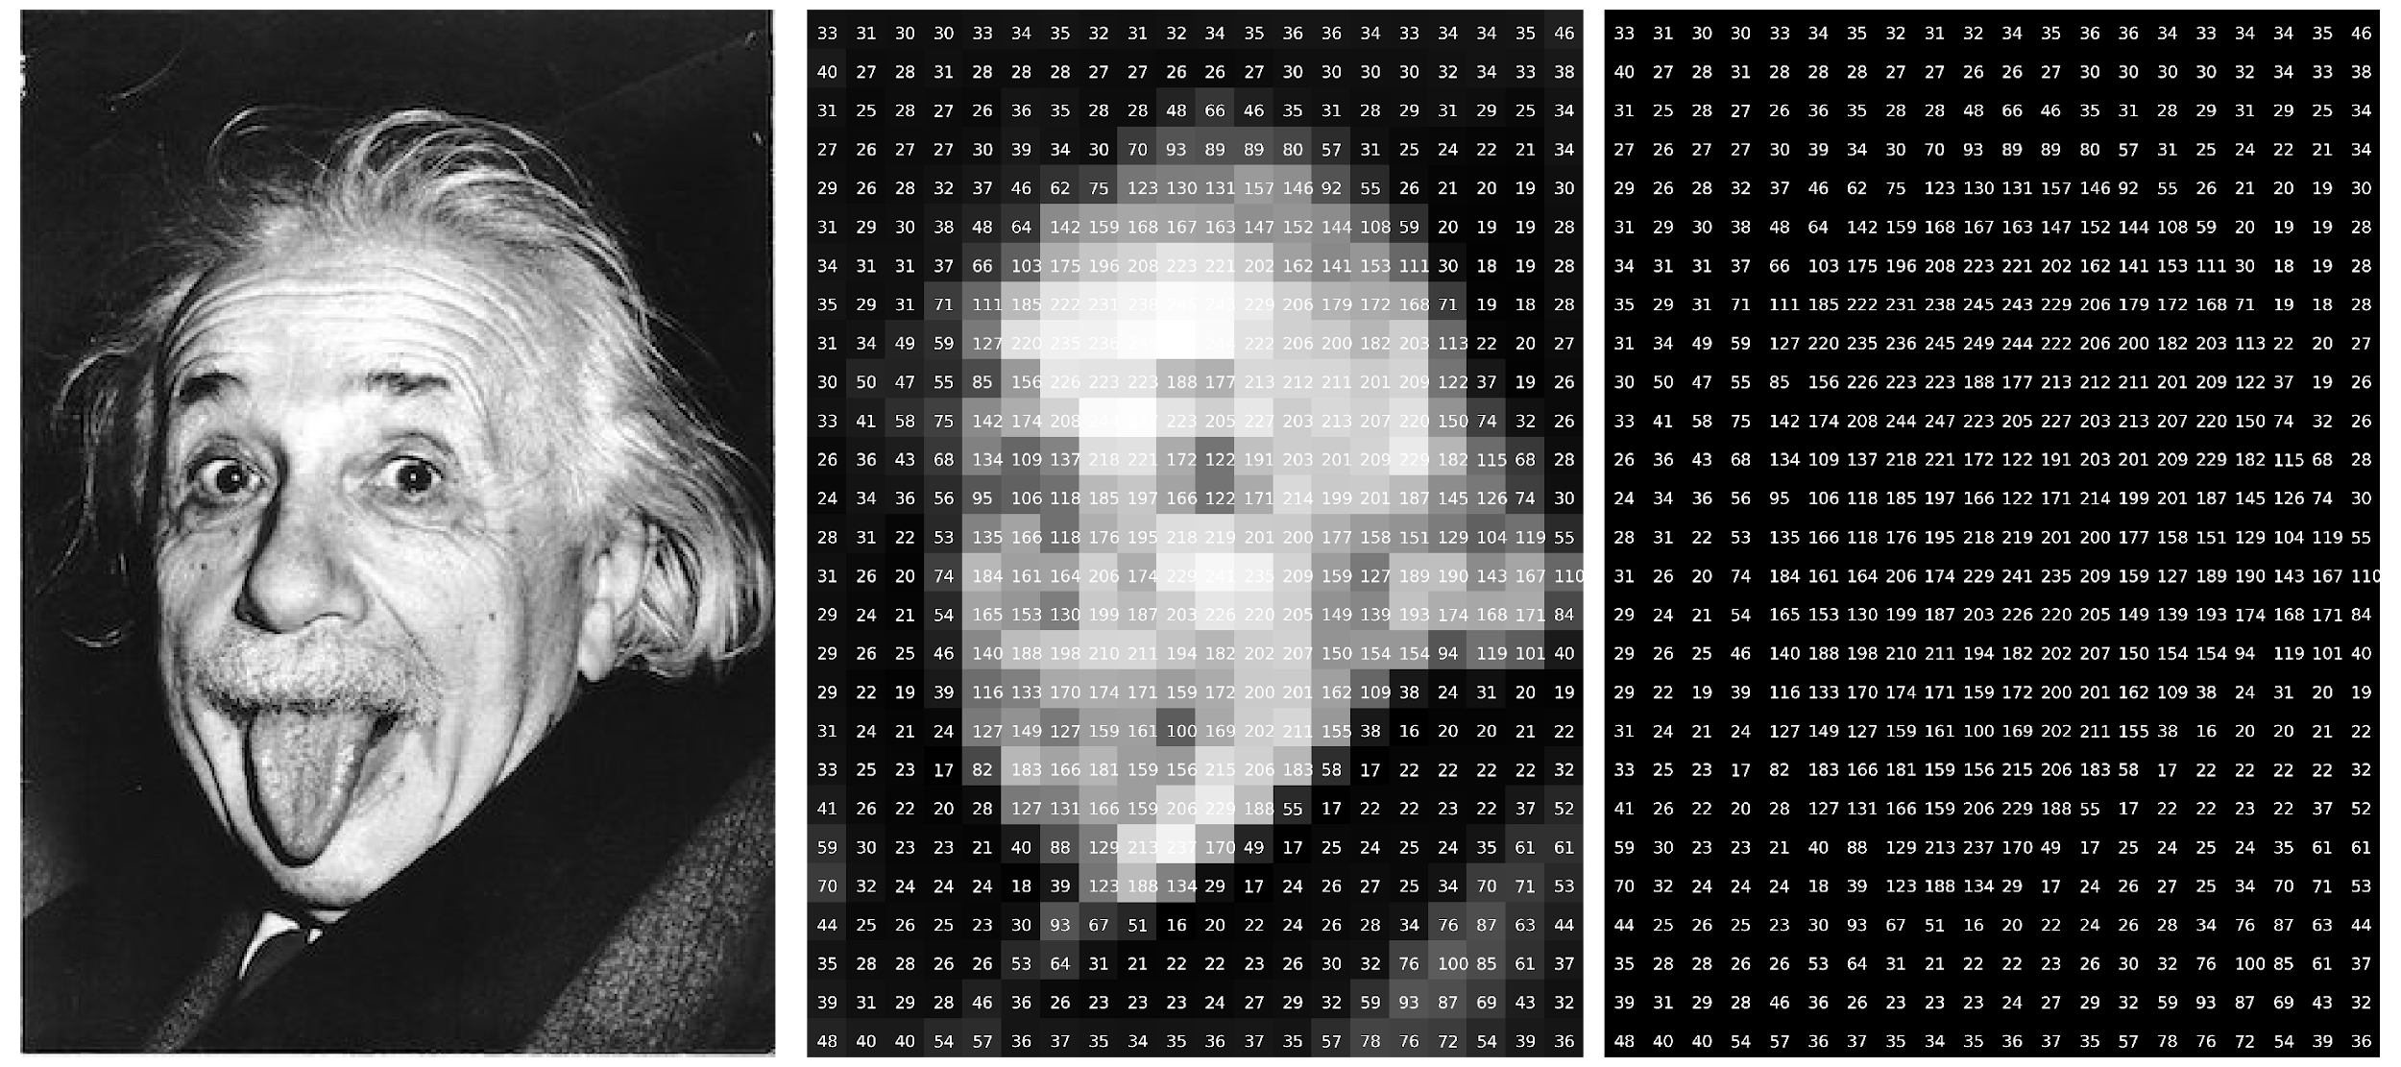
Raster image – an example

Slide 15
Vector images in Deep Learning Research
Vector images are not used to train deep learning models but…
They should be used in publications as they can be scaled and appear very sharp when published on papers or posters (typically in A0 format).
Matplotlib can easily export in vector formats (EPS, PDF, etc.) any figure you generate

Slide 16
Image features
Resolution (relevant for quality)
Dot per inch (DPI) (relevant for printing)
Compression (relevant for storage and quality)
Transparency
Anti-aliasing
And many more.
In deep learning normally those features (except resolution) are irrelevant.

Slide 17
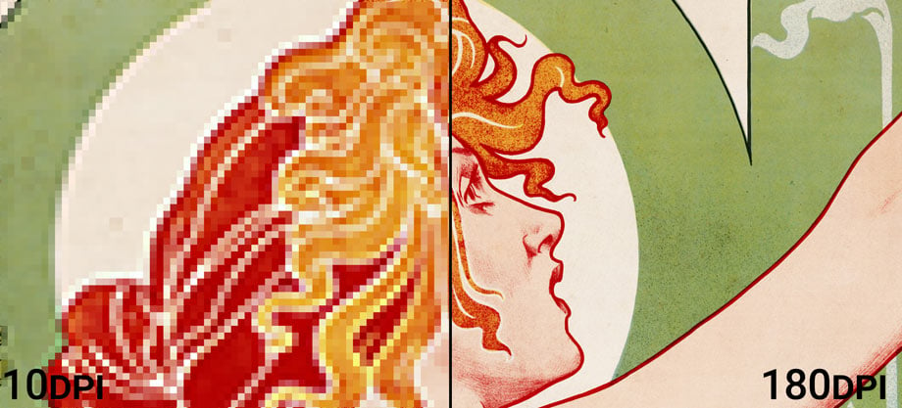
DPI: an explanation
https://prinfab.com/blog/viewing-distance-and-dpi/

Slide 18

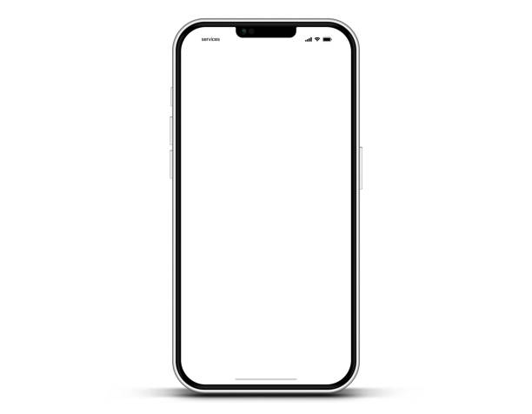
DPI: an explanation
~ 220 dpi
~ 400 dpi
https://prinfab.com/blog/viewing-distance-and-dpi/

Slide 19
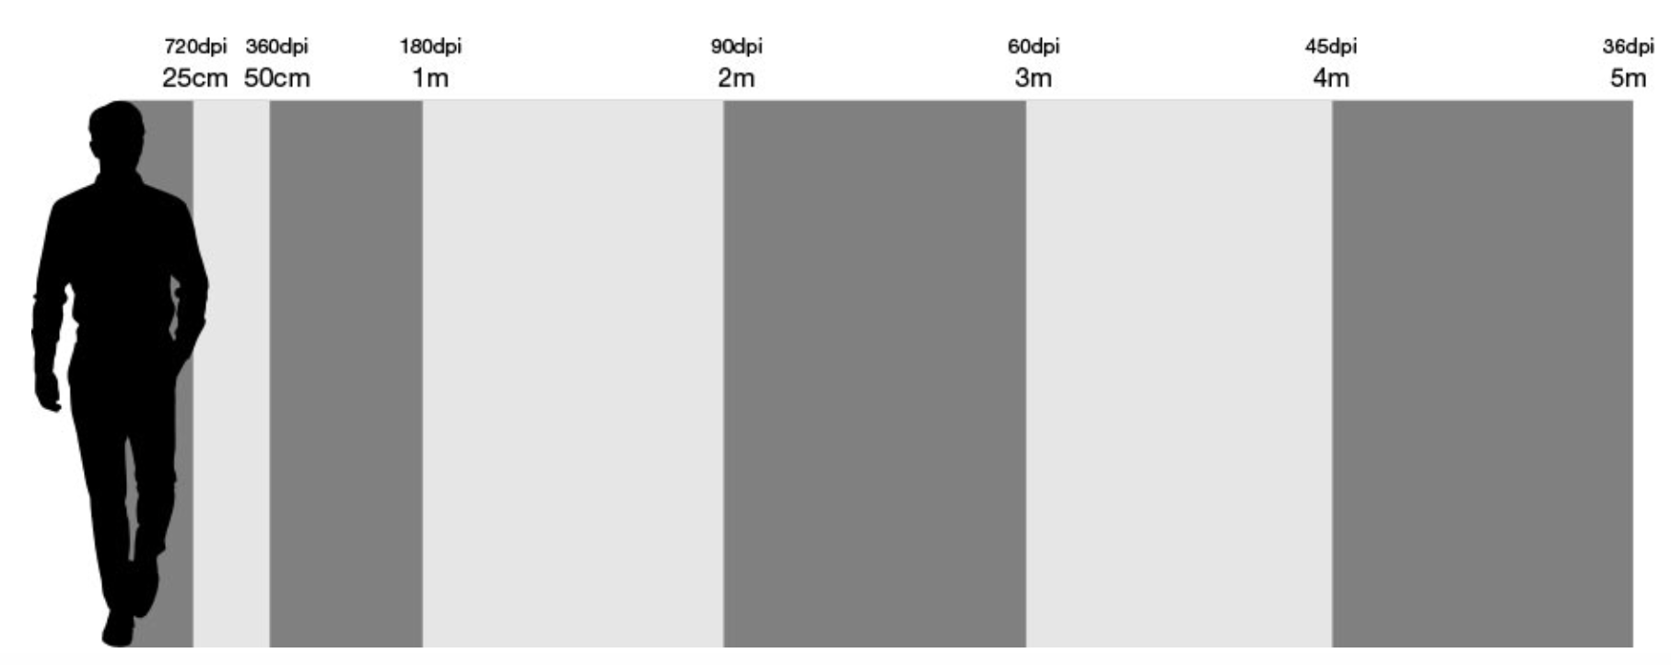
DPI: an explanation
The closer you are to a printed image, the higher you should choose the DPI.
https://prinfab.com/blog/viewing-distance-and-dpi/

Slide 20
Characteristics of images
Image size (storage space).
Image resolution.
Number of channels (1 for B&W, 3 for colors in RGB and 4 for CMYK, 4 with transparency).
Color Depth (number of bits to describe the color).
Compression (lossless or lossy).
Specific formats (way in which the information is stored digitally).

Slide 21
Colors and Resolution in Deep Learning: some notes
Colors may contain information and thus increase deep learning model performance.
This is not always obvious and needs to be tested.
The optimal resolution needs also to be tested. Large resolution will lead to very slow training.
Almost all pre-trained models expected specific resolution, so resizing is often needed.

Slide 22
Python libraries for image processing
Pillow/PIL - https://pillow.readthedocs.io/en/stable/
openCV - https://opencv.org/
Scikit-Image - https://scikit-image.org/
Scipy (it does offer some machine learning algorithms, as face detection) - https://scipy.org/
Mahotas - https://mahotas.readthedocs.io/en/latest/
TensorFlow - https://www.tensorflow.org/api_docs/python/tf/image
PyTorch - https://docs.pytorch.org/docs/stable/index.html

Slide 23
Image Formats for PyTorch
PyTorch uses PIL (Python Imaging Library) or torchvision for image loading
Supported Formats:
  JPEG, PNG, BMP, GIF, TIFF, WebP
Best Practice: Use JPEG or PNG for most tasks due to wide support and efficiency

Slide 24
Image Formats for TensorFlow
TensorFlow uses tf.io and tf.image modules
Supported Formats:
  JPEG, PNG, BMP, GIF
TFRecord: TensorFlow’s own binary format for large datasets
The datatypes are all Tensors, thus the code is optimized and no conversions are needed.

Slide 25
Code Discussion
Introduction to Image Processing

